Slide 1
GIT
Version control system

Slide 2
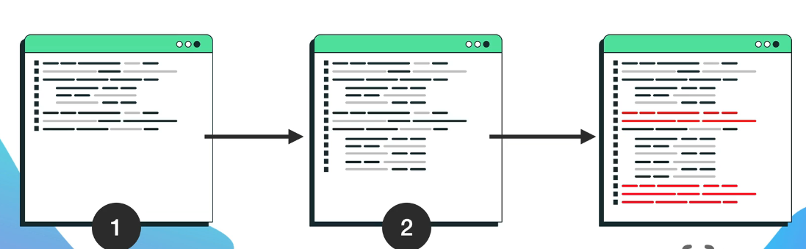
GIT
🔹 Git is the most popular version control system, which allows you to track changes to your code and make it easier to work with your team 👉 Git allows you to revert to any previous version!
Git uses snapshots of your code, so you can: ✔ Compare the current code with old versions ✔ Revert to any previous version ✔ Work with a team without worrying about data loss.
Notes:
Teacher Notes:
Explain what version control is and why it matters for both solo and team projects.
Demonstrate the “snapshot” model: how Git stores commits as a directed graph of snapshots, not diffs.
Show a quick comparison of editing a file locally vs. committing changes to illustrate safe experimentation.
Resources:
Official Git Documentation – What is Version Control?
GitHub Learning Lab – Introduction to Git
Additional Reading:
Pro Git by Scott Chacon and Ben Straub (Chapters 1–2)
Version Control with Git by Jon Loeliger and Matthew McCullough

Slide 3

GIT - EXERCISE
- Create an account on GitHub - Install git on your computer
Notes:
Teacher Notes:
Walk students through creating a free GitHub account and setting up two‑factor authentication.
Demonstrate installing Git on Windows/Mac/Linux and configuring git config --global user.name and user.email.
Explain the importance of SSH vs. HTTPS for remote operations and show how to generate an SSH key.
Resources:
GitHub Docs – Set up Git
Atlassian – Git Installation Guide
Additional Reading:
Git Pocket Guide by Richard E. Silverman
Learning Git by Anna Debenham

Slide 4
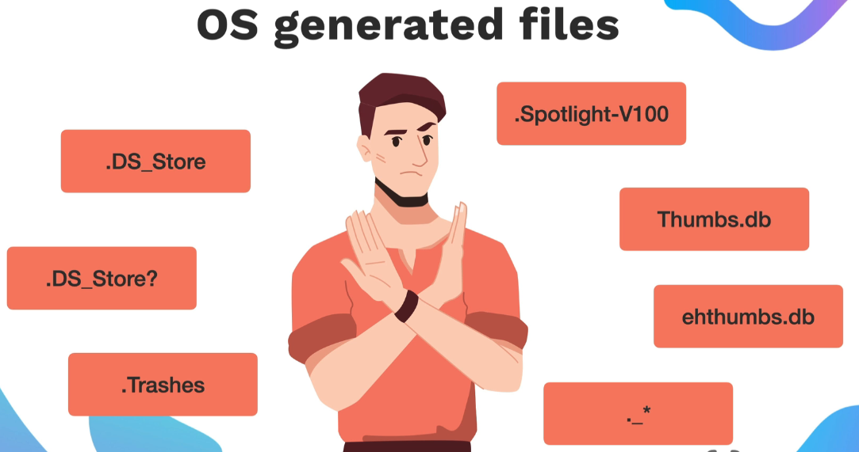
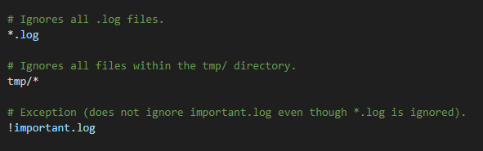
GIT - .GITIGNORE
👉 We use it to prevent certain files from being added to the Git repository. This is extremely important to protect sensitive data (API keys, passwords, private settings) and avoid unnecessary sharing of local settings with the rest of the team
Notes:
Teacher Notes:
Describe how .gitignore uses glob patterns to exclude files (e.g., node_modules/, .env, *.log).
Show examples: adding a .env file to protect API keys, ignoring IDE/editor configs.
Demonstrate using gitignore.io to generate language‑specific templates.
Resources:
Git SCM – Ignoring Files
gitignore.io – Generate .gitignore templates

Slide 5
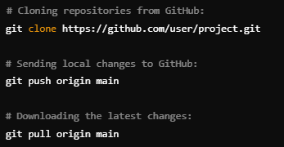
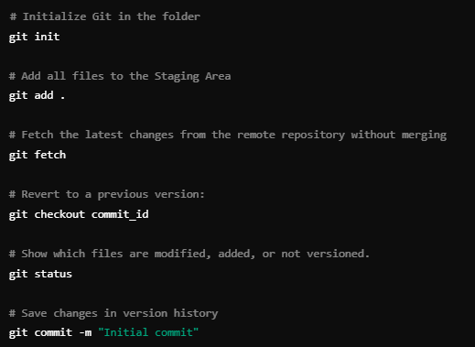
GIT - COMMANDS
Notes:
Teacher Notes:
Cover the workflow: git init, git status, git add, git commit.
Show history exploration with git log and comparison with git diff.
Introduce branching: git branch, git checkout -b, merging with git merge.
Explain fetch vs. pull, and pushing changes: git push, git pull.
Resources:
Atlassian – Git Command Reference
Git SCM – Git Cheat Sheet
Additional Reading:
Git Pocket Guide by Richard E. Silverman
Pro Git by Scott Chacon and Ben Straub (Chapter 3, “Git Branching”)

Slide 6
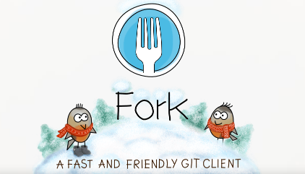
GIT - EXERCISE
✅ Create a local Git repository ✅ Add and commit changes ✅ View commit history ✅ Revert to previous versions ✅ Work with a remote repository on GitHub
Notes:
Teacher Notes:
Live‑demo creating a local repository (git init), making several commits, and using git log/git checkout to revert to a previous state.
Walk through connecting to GitHub: git remote add origin <URL> and git push -u origin main.
Show how to clone an existing repository (git clone) and contribute via feature branches and pull requests.
Resources:
GitHub Docs – Hello World Tutorial
Git SCM – Cloning a Repository
Additional Reading:
Version Control with Git by Jon Loeliger and Matthew McCullough
Git Magic by Ben Lynn (free online book)

Slide 7
GitHub Docs – Hello World Tutorial
Git SCM – Cloning a Repository
Version Control with Git by Jon Loeliger and Matthew McCullough
Git Magic by Ben Lynn (free online book)

